Slide 1
ICANN | FY14 Draft Operating Plan and Budget

Slide 2
Table of Contents
Introduction
Organizational Transformation
Planning Process Overview
FY13 Forecast Update
Statement of Activities
Revenues
Variance Analysis
FY14 Draft Operating Plan and Budget
Financial Data
Statement of Activities
Revenues
Variance Analysis
Headcount
Management Delivery – AtTask
Community Support Requests
New gTLD Program

Slide 3
Overview
This FY14 Draft Operating Plan and Budget sets forth the proposed focus of efforts and organizational commitments for the next fiscal year.
This proposal will be modified as a result of feedback from the community and ICANN’s Board, and will be considered for adoption in June 2013.
Really? How much room for change is there in this budget? It would be helpful to know the discretionary/flexible parts of the budget.

Slide 4
Background
This document provides context for the budget development process and qualitative and quantitative descriptions of FY14 operational activities.
During the current fiscal year, there have been significant process improvements that have impacted the organization and as a result, the current and future year planning processes.
This document will provide an overview of those changes, with a description of what is in place and what is yet to implemented.

Slide 5
Content
Update on the current year financial information, including:
Key changes between the FY13 approved Budget, and a full year forecast of the FY13 financial data established after 7 months of activity.
FY14 suggested Budget information and main changes between the FY13 Forecast and the projected FY14 Budget.
Comprehensive breakdown of the FY14 budgeted costs across all the projects and activities carried out by the organization, using the internal management system AtTask, also visible on myICANN.org.

Slide 6
Organizational
Transformation

Slide 7
FY13 and FY14: Continued Transformation
Following the launch of the New gTLD Program in FY12, ICANN has continued on the path of accelerated changes in FY13.

Slide 8
FY13 and FY14: Continued Transformation
Most of the initial evaluation phase of the New gTLD Program has been carried out, representing the majority of the entire evaluation process. Meanwhile, the organization has welcomed a new CEO.
The new leadership has brought immediate focus on the transformation of the organization towards operational excellence, has initiated a renewed and expanded stakeholders’ engagement activity, and has addressed the strategic requirements of the New gTLD Program.
The resources of the organization for FY13 have been carefully concentrated on these areas with an emphasis on acquiring required talent and selectively completing critical projects, allowing operating expenses to remain below budgeted levels.

Slide 9
FY13 and FY14: Continued Transformation
It looks like we’re already committed to this dramatic change of the organization – but what happens if we can’t sustain it or it causes damage? Is there room for some “pilot before we roll” behavior?
In FY14, the organization will implement strategic initiatives designed in FY13:
Transforming into a worldwide matrix organization, expanding ICANN’s presence internationally, thus allowing a truly global stakeholders’ engagement
Implementing a DNS Industry Engagement organization
Further strengthening the infrastructure.
These ambitious changes will drive an increase of expenses across most areas of the organization, while funding also increases as a result of the new registries progressively starting operations.
There seem to be a number of overlapping initiatives in this area (detailed in subsequent slides). Issues: redundancy, scope-creep, over-rapid expansion, questions of ICANN’s role in promoting the “DNS Industry”
SSR staff/infrastructure, and bottom-up policy making bodies, are suffering in this budget.
What happens if these revenue assumptions are wrong. What if the gTLDs are delayed – does ICANN create an ambiguous role for itself by having a stake in, and a bet on, the timing and size of that new revenue stream?

Slide 10
Planning Process
Overview

Slide 11
Target Planning Process Overview
STRATEGIC PLAN
Long Term Design
BUDGET & OPS PLAN
Annual Update
EXECUTION
Recurring Monitoring
Organization-wide Objective/Goal
Outline Required Resources
Interdependent Projects /Activities
Cyclical Projects and Tasks assigned during Fiscal-Year Timeframe
Fulfill Core Deliverables and Services
OBJECTIVE
GOAL
PROGRAM
PORTFOLIO
PROJECT
TASK

Slide 12
Budget process – Mid-year change
Phase 0
Budget improvement process
Recommended changes
Framework
Generate early detailed project data
Multiple interactions Staff/Community
Final draft
Earlier public comment
Marginal changes to budget
New CEO
Original plan
Implementation of AtTask
Final Draft
Define FY14 projects and activities in AtTask
Develop Budget
Public Comment
Revised approach
Where is the “change the budget” part of this new process? Or does the process stop with public comment. Are we just providing comment on an already-frozen budget?

Slide 13
FY13 Forecast Update

Slide 14
FY13 Forecast vs. FY13 Published Budget (In thousands)
There’s good news in FY13 – but wait for it, most of this is offset in FY14. This is primarily an artifact of new-gTLD delays. Since that program is front-loaded with expenses, delays generate good news in early years, bad (to very-bad) news in later years. Are we ready?

Slide 15
FY13 Forecast vs. FY13 Published Budget - Revenue (In thousands)
Is there a contingency plan if these numbers actually reflect a flattening/maturing of demand for domain names, both in existing and new gTLDs? How much of the expansion of ICANN described in this budget be gracefully unwound if things don’t turn out the way we hope? Is there a plan to protect core functions in that scenario?

Slide 16
FY13 Forecast Variance Analysis – Revenue (In thousands)

Slide 17
FY13 Forecast Variance Analysis – Operating Expenses (In thousands)
Just as the Compliance function was starved for years, this is troubling. Is this $1.2 million of projects: being carried forward in base, cancelled, or are they a part of the $1.6 million on page 22 (so there’s really only $.4 million in new money)?

Slide 18
FY14 Draft Operating Plan
and Budget
Financial Data

Slide 19
FY14 Draft Operating Plan & Budget vs. FY13 Forecast (In thousands)
Here’s the “bad news” half of the favorable variance in FY13. Of the $76m gained, $62m shifted into unfavorable variance in FY14 due to delays in new gTLD, and higher than anticipated withdrawals. That’s OK, but only if there are no more delays and withdrawals stay on track – which risks reducing some of ICANN’s independence in overseeing the new gTLD project as ICANN becomes tied to program performance.

Slide 20
FY14 Draft Operating Plan & Budget vs. FY13 Forecast - Revenue (In thousands)

Slide 21
FY14 Draft Operating Plan & Budget Variance Analysis – Revenue (In thousands)
This reads strangely to me. It seems to imply that expenses are a cause/driver of revenue. Are revenues being treated as deferred, and being realized on the basis of progress toward contract? If that’s the case, is ICANN really an independent evaluator?

Slide 22
FY14 Draft Operating Plan & Budget Variance Analysis (In thousands)
This is the smallest pile of new money – are we starving the bottom of the bottom-up process?
This is by far the largest increase. What’s the rationale for this scale of increase/scope-gallop/reorganization. Are there measures of success. Are there rollback options if if fails? Can we pilot some of these initiatives before committing this much money?
How much of this increase is for things that the community agrees are in scope? EG DNS Industry Mgt?
How much of this is the $1.2million in deferred Security money from FY13?

Slide 23
FY14 Draft Operating Plan & Budget Headcount by Function

Slide 24
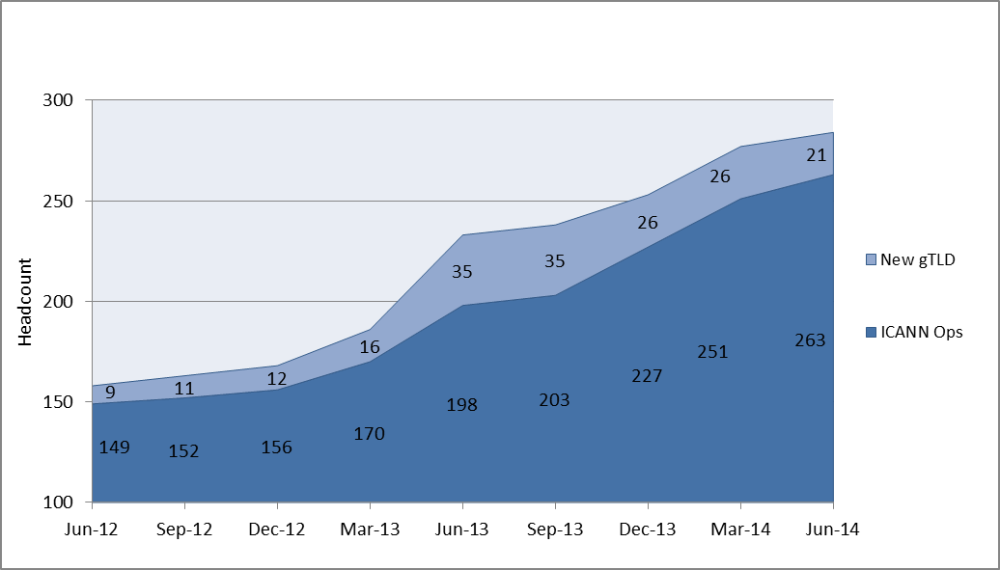
FY14 Draft Operating Plan & Budget Headcount Growth

Slide 25
FY14 Draft Operating Plan
and Budget
Management Delivery

Slide 26
Management Delivery: Objectives & Goals
w. FY14 Draft Budget
DELIVER CORE INTERNAL FUNCTIONS
ACT AS STEWARD OF PUBLIC INTEREST
ENGAGE IN IG ECOSYSTEM
DEEPEN PARTNERSHIP WITH I-ORGS.
$15.6M
INSTITUTIONALIZE MGMT. DISCIPLINES
MATURE ORG. SUPPORT FUNCTIONS
OPTIMIZE R&R SERVICES
PLAN FOR SCALE, SECURITY, CONTINUITY
$106.4M
(of which $57.6M is related to the New gTLD program)
1
AFFIRMATION OF PURPOSE
2
OPERATIONS EXCELLENCE
3
INTERNATIONALIZATION
4
MULTI
STAKE
HOLDER
ENGAGE STAKEHOLDERS GLOBALLY
COMMUNICATE CLEARLY & LOCALLY
INTEGRATE GLOBAL/REGIONAL RESP.
EVOLVE GOV. RELATIONSHIPS
$11.9M
MODEL EVOLUTION
OPTIMIZE POLICY DEV. PROCESS
INCREASE/IMPROVE PARTICIPATION
EVOLVE SO/AC STRUCTURES
PROMOTE ETHICS & TRANSPARENCY
$8.2M
Are these two efforts being coordinated? If they’re not, we run the risk of drawing many new participants in, but not providing them with a landing pad or a path to constructive engagement. What role, if any, is envisaged for AC/SO’s in this? Do they have the capacity to deliver what’s expected?

Slide 27
Management Delivery: AtTask Structure Overview
OBJECTIVES
GOALS
PORTFOLIOS
PROGRAMS
Core foundational strategies upon which measurable targets are based
Desired achievable outcome to meet an organization-wide objective
Cross-functional work undertaken in support of goals to fulfill core deliver-ables and services
Group of inter-dependent projects/ activities managed in a coordinated way to obtain benefits
Status Key: (Status is measured against expected completion dates)
On Target Project dates are on track to meet the estimated planned completion date
At Risk Project dates are tracking behind the estimated planned completion date
In Trouble Project dates are tracking late the estimated planned completion date
Complete Project is completed
Description – a detailed definition of the scope of work
Owner – name identified with each entry that is responsible for the work at ICANN
Timeline – target date designated for completion or, for ongoing work for the current fiscal year (e.g. FY13T3)
Metric – description of quantifiable measurement(s) of success
Priority – indicates level of priority within the fiscal year (e.g. Urgent, High, Normal and Low)
Dependencies – resource or activity that is critical to the success for completing the work
Risks – factors that may have a negative impact on successful completion of the work
Stakeholders – parties who are either interested or impacted by the work
ICANN transitioned to this centralized Portfolio Management System in January 2013. Work is still ongoing to develop consistency and uniformity to the system.
Information found in the ICANN Portfolio Management System will be continually updated. It is an information source for informal reference only.
It should not be used as an official source of information about ICANN or its work.

Slide 28
FY14 Draft Operating Plan & Budget – AtTask (In thousands)

Slide 29
FY14 Draft Operating Plan & Budget – AtTask (In thousands)
How does this differ from IG Ecosystem below?
What does $28k buy? Does it move the needle?

Slide 30
FY14 Draft Operating Plan & Budget – AtTask (In thousands)
What does $9k buy? Does it move the needle?
What’s in “services” vs. “operations”? Is “services” the bucket for supporting the new trade organization?
What does $3k buy? Does it move the needle?
Is this coordinated with the “security, stability and resiliency” bucket on the previous page?

Slide 31
FY14 Draft Operating Plan & Budget – AtTask (In thousands)
How much of this is office cost, vs. actually engaging with people? Does this include a lot of on-ramping for new people once they arrive or do we leave them to fend for themselves? What’s their path to productive participation?
What does $99k buy? Does it move the needle?

Slide 32
FY14 Draft Operating Plan & Budget – AtTask (In thousands)
How does this differ from “optimize policy development process” below?
What does $6k buy? Does it move the needle?
How does this differ from “engage stakeholders globally” on the previous slide?
Can we pilot this first, then deploy it if it works?
How does this differ from “enable cross stakeholder collaboration” below and “engage stakeholders globally” on the previous slide? Are these initiatives coordinated so that new arrivals have a clear path to effective participation?

Slide 33
FY14 Draft Operating Plan
and Budget
Community Requests

Slide 34
FY14 Draft Operating Plan & Budget – Community Support Requests (In thousands)

Slide 35
FY14 Draft Operating Plan & Budget – Community Support Requests

Slide 36
FY14 Draft Operating Plan & Budget – Community Support Requests Cont.

Slide 37
FY14 Draft Operating Plan
and Budget
New gTLD Program

Slide 38
New gTLD Program – Financial Summary (In thousands)
See next page for Mikey’s supporting documentation
I think this should be (13,000)
Which then ripples through the rest of this analysis
Eg: this would now be (26,056)
Eg: this would now be (21,856)
In any event, isn’t this last-corner number a NEGATIVE variance, so shouldn’t it be in brackets?

Slide 39
New gTLD Program – Financial Summary (In thousands)
The variance seems high at $17,004. Check my arithmetic:
The sum of variances as listed in this paragraph is:
$5.8 + $3.2 + ($24) + $7.3 + ($5.3) = ($13)
So I would put the variance at -$13 million rather than -$17 million as listed. Can we take the $4 million I’ve found and put it into Working Groups?
Projected withdrawals of 645 seem low. Please check my arithmetic:
The sum of actual/projected withdrawals listed is: 1+35+470+150=656. Presumably pre-reveal withdrawals is a positive number, making this bigger.
I don’t know what the pre-reveal refund rate is. If it’s 100% that means $5.3m of refunds from pre-reveal would work out to roughly 29 additional withdrawals. A 90% refund rate would drive that to 32 pre-reveal withdrawals.
So I calculate projected withdrawals at 656 plus either 29 or 32 – a range of 685 to 688 total projected withdrawals.
Partly, the arithmetic seems wrong. Partly, 685 strikes me as an optimistic estimate. Granted, estimating error has less impact the further through the tiers we get.

Slide 40
New gTLD Program – Financial Summary (In thousands)
That $4 million difference also shows up here, it should be (-$13 million), and ripples through this page as well.

Slide 41
New gTLD Program – Operating Expenses (In thousands)

Slide 42
New gTLD Program – Expense Variance Analysis
(In thousands)
These strike me as high cost per head
Variance | Headcount | $/head
$1,800 | 7 | $257k
$1,000 | 3 | $333k
$600 | 10 | $60k
$400 | 1 | $400k
$100 | 2 | $50k
This strikes me as high, as a variance

Slide 43
New gTLD Program – Multi-Year View (In thousands)

Slide 44
Thank You

